Slide 1
Rocket Math
Rashne Hassan, Morgan Weaver, Hugrun Helgadottir, Ella Hedman

Slide 2

Goal / Motivation
Real world application
Teaching grade school students simple math problems and a fun way to practice them
Can also use for children with learning disabilities
Fun math game
Modes:
Multiple choice mode using buttons on the FPGA
Type answer option using the keyboard
Operations: +, -, *
https://www.pellearning.com/blog/comparing-kumon-with-pel-learning-programs-which-is-a-better-program-for-your-child/
Notes:
Huugs - hi everyone my name is Hugrun, Ella, Mo, Rashne and today we are going to introduce to you our fun math game on the fpga. The game is called Rocket math, a math question will pop up on the screen and you will have limited time to answer. There are two ways two input an answer based on the mode. One way is that you have a multiple choice question where you will press a button on the FPGA to input the correct answer and the other you have to input the correct answer using the keyboard. Since we have all grown up being super competitive we thought what better way to learn math than to turn it into a fun, competitive game. The real world application would be to teach grade school students simple math problems and giving them a fun way to practice them.

Slide 3
Game Modes
Operation (User choice via switch)
Operation (User choice via switch)
Multiple Choices (FPGA Buttons)
Answer (Keyboard input)
Random Number Digits
Random Number Digits
Mode 1
Mode 2

Slide 4

Functionality
The score is based on how many correct answers the user has entered in a certain time
Points and timer displayed on the 7-segment display
As the player gets more points, the time limit to answer the question will get shorter and the questions get harder
The score and timer will display on the FPGA seven segment displays and the lives will be displayed using the LEDs
The player will get 3 lives
Reset the game with a button
https://www.psychologs.com/wp-content/uploads/2023/08/How-to-help-kids-Overcome-Math-Anxiety.jpg
Notes:
Morgan
Timed test on operations

Slide 5
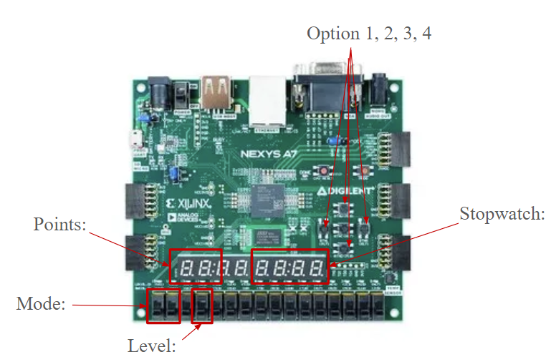
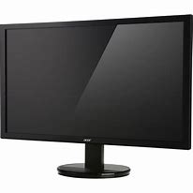
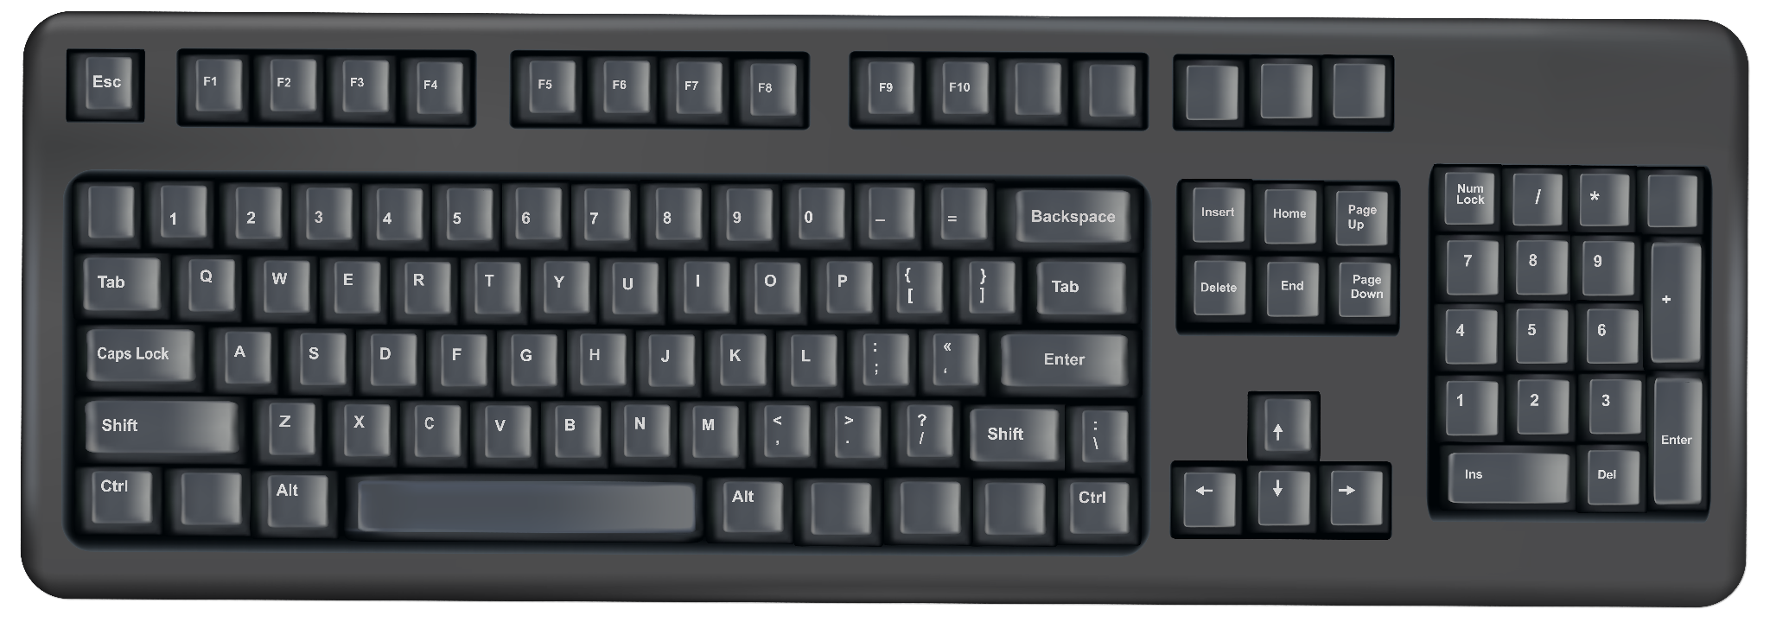
Specification
Requirements | Constraints
Keyboard input by user | User is limited to three operations
VGA | Limited time on the FPGA
FPGA - buttons, switches, led | Only Enter 3 digit numbers / no decimals
Notes:
Rashne:
Project Description for Keyboard Games: create games you can play via a keyboard. These should include scores, levels, progressive difficulty, host computer visualization, etc
Our Implementation:
Keyboard is the user input
Score based on correct answers to the questions and displayed on FPGA
2 Levels - Multiple choice (easy), typing answer (difficult)
Progressive Difficulty with the time limit on answering questions
Host computer visualization using the VGA (images shown on previous slides)
Constraints for user:
Operations
Limited by team time otherwise would add more features such as feedback on what problems went wrong and why

Slide 6
Detailed Block Diagram
Switches for Operation
Random Number Generator
ALU - Addition, Subtraction, Multiplication
VGA
Answer Check
VGA Display Module
Keyboard
Stopwatch
FPGA Buttons
Point Total / Lives
MUX
7-Segment Display
Game Mode Switch (FPGA Buttons vs Keyboard)
Clock
LED’s
Notes:
Ella
Multiple choice module has not been added in yet

Slide 7
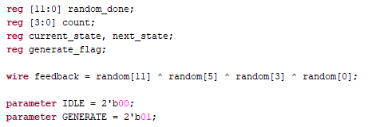
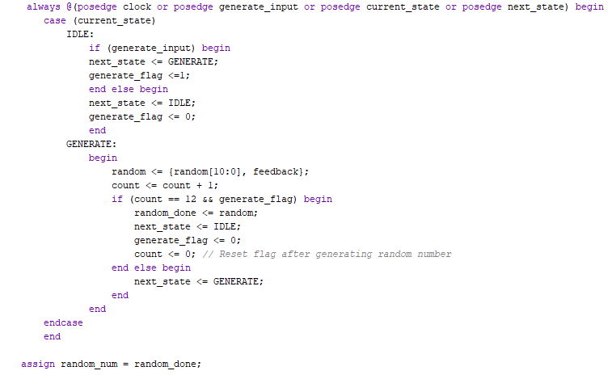
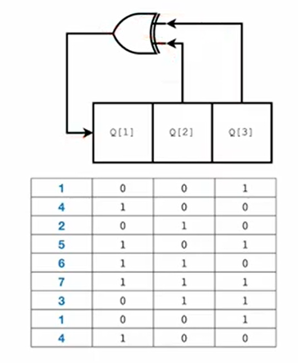
Random # Generator Code
12-bit Number Generator
LFSR: Linear Feedback Shift Register
(Not 100% random)
FSM to only get one random number
Notes:
If random_done is changed then change states??
https://simplefpga.blogspot.com/2013/02/random-number-generator-in-verilog-fpga.html
https://simplefpga.blogspot.com/2013/02/random-number-generator-in-verilog-fpga.html

Slide 8
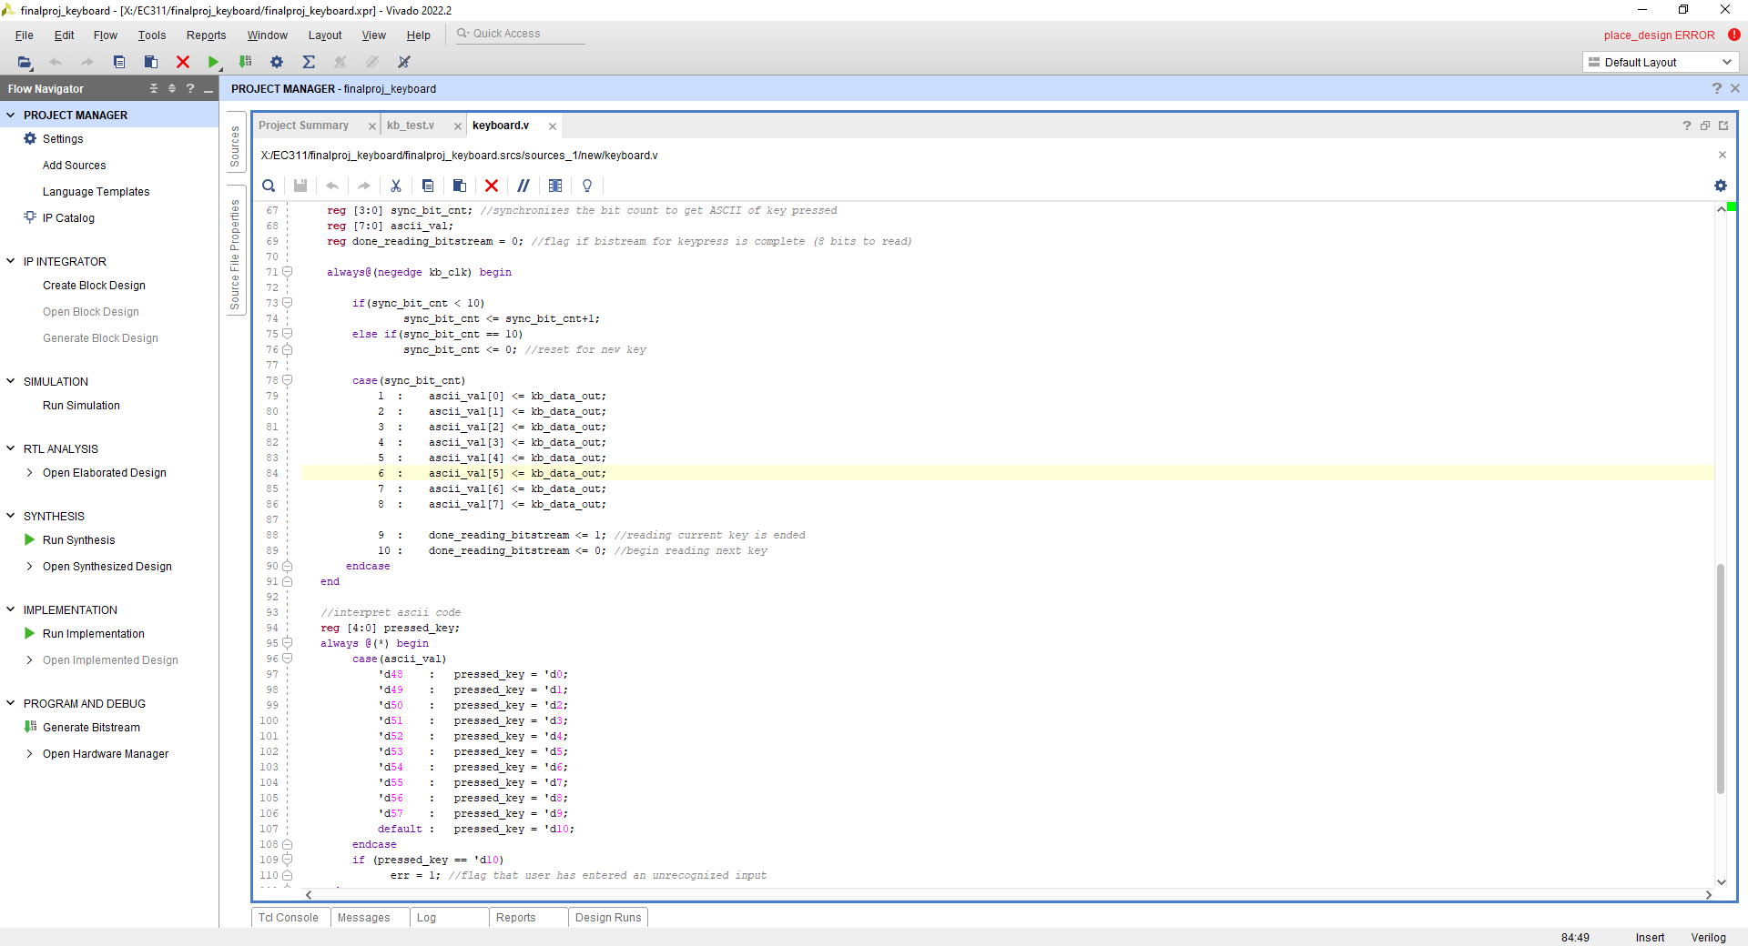
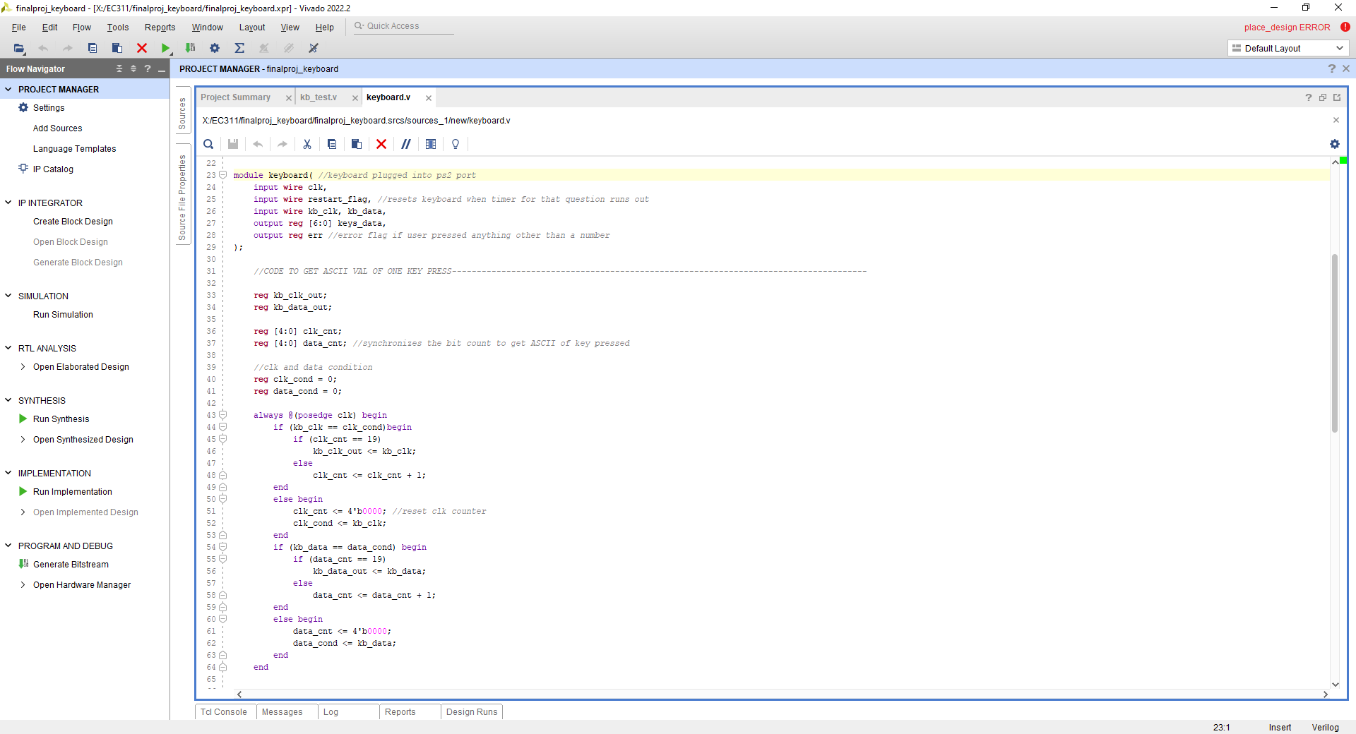
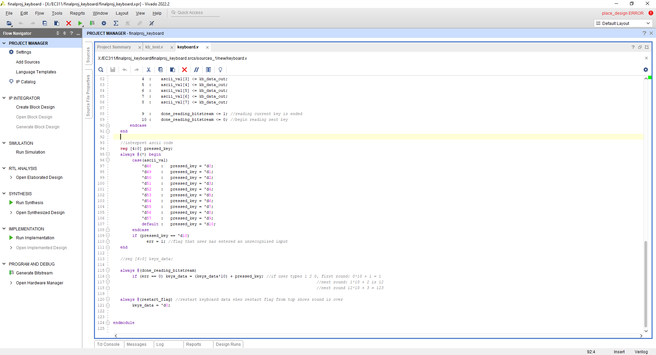
Keyboard Code
A keyboard.v file that inputs kb_clk and kb_data and outputs ASCII values
A getTypedIn.v that uses an FSM interprets the ASCII values into one multiple digit number that is output and compared to the 7 bit register of the expected answer.
Read Key Press
pressed_key <= (interpret) pressed_key_ASCII
kb_input <= (kb_input * 10) + pressed_key
reset_flag or enter_pressed
~reset_flag
back_space
Reset Input
kb_input <= 0
err <= 0
Read Key Press
kb_input <= kb_input - pressed_key
Notes:
If random_done is changed then change states??

Slide 9
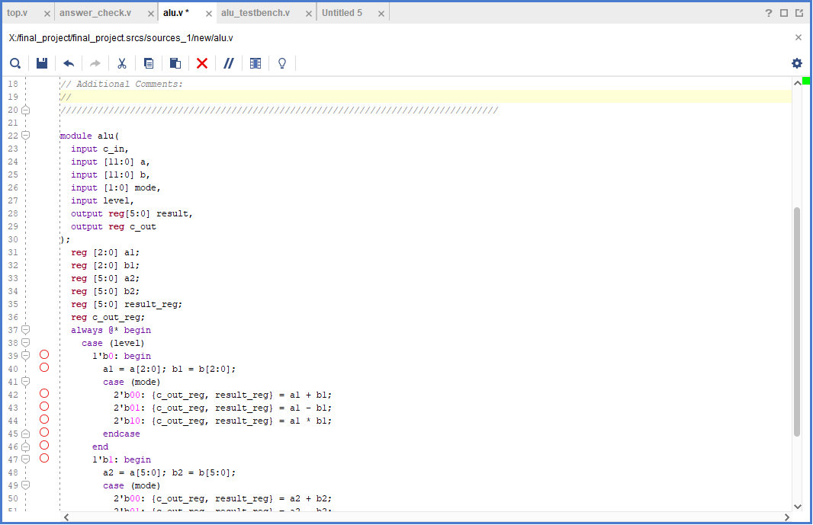
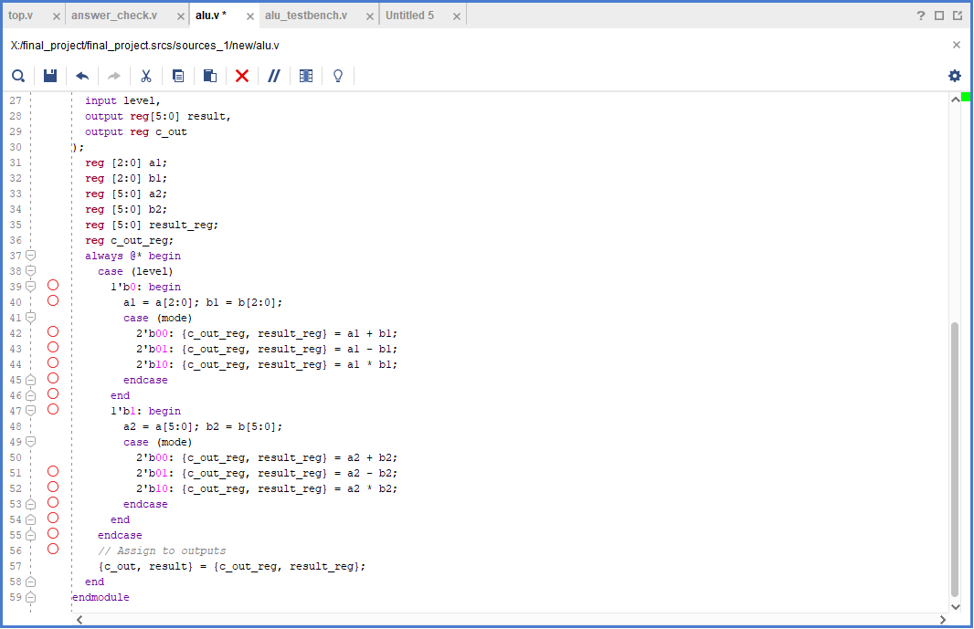
ALU Code
ALU takes in the random numbers generated, and calculates the expected value to be entered by the user
Collects a different number of bits based on the level (one digit vs two digit operations)
Modify for multiple choice mode
Notes:
Ella

Slide 10

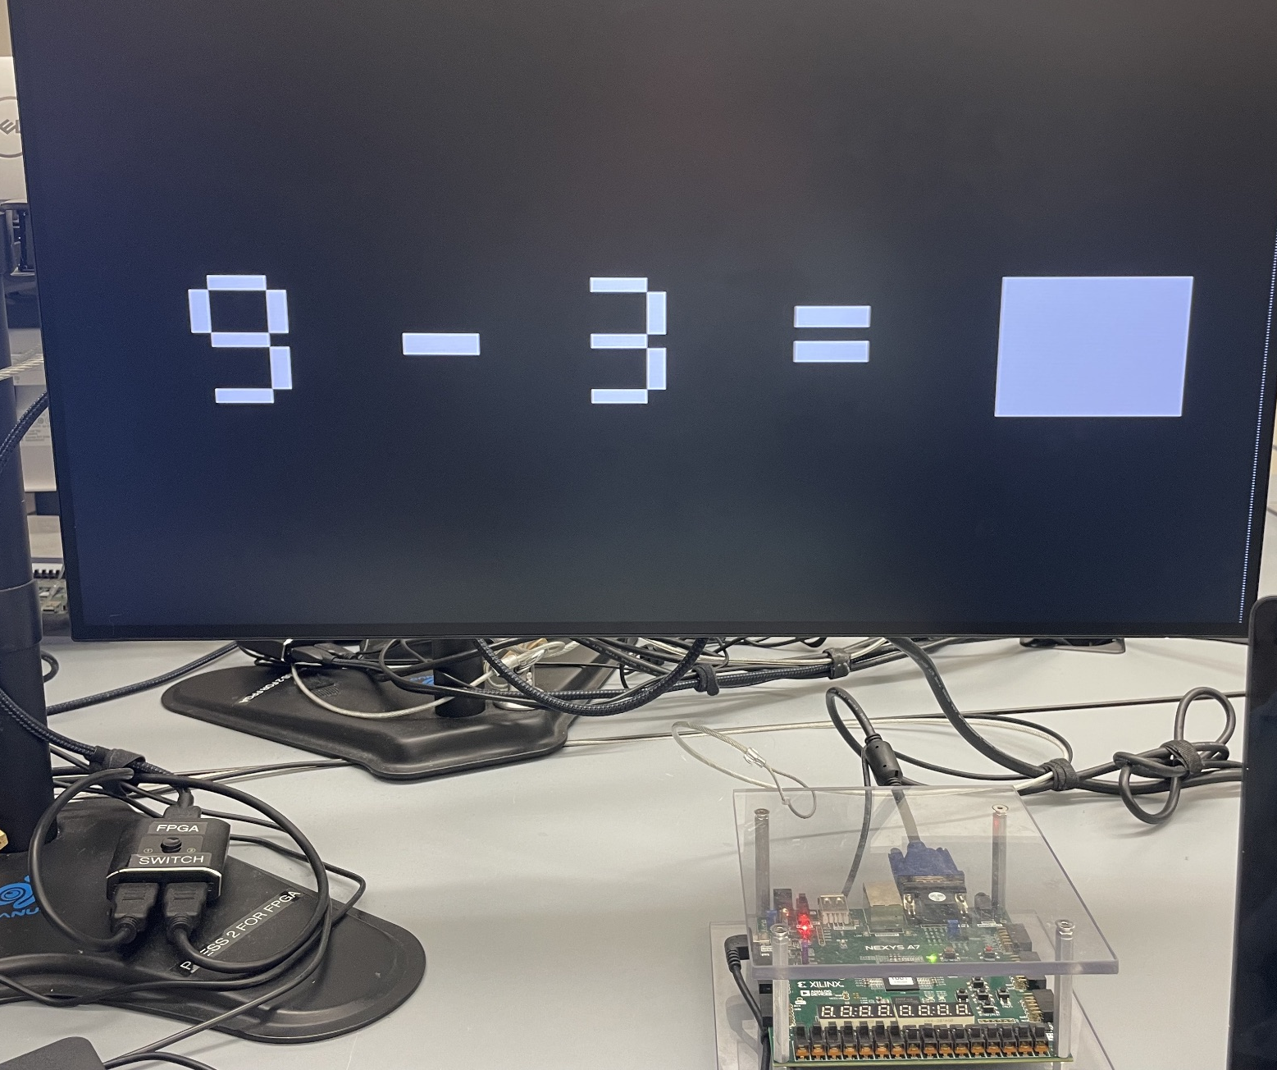
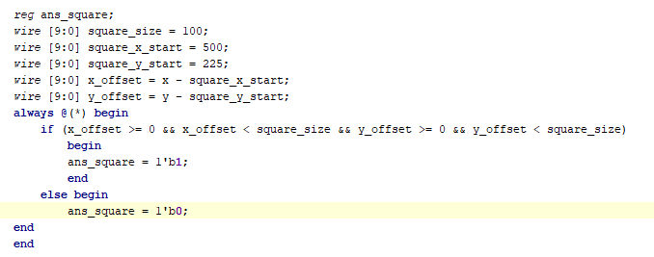
VGA display screens and code
Notes:
Hugs - To implement the VGA display works we need to take the internal clock of the fpga which is 100MHz and use a clock divider to get it down to 25MHz. Then what happens is that we have a horizontal counter and a vertical counter that goes through every pixel on the screen. The horizontal counter starts counting until it has reached the end of the screen it then sends a signal to the vertical counter that goes down one and the horizontal counter starts again. It works like a nested for loop. We had some difficulties trying to print symbols and numbers on the screen, so we figured out how to hard code it by changing the pixels inside of a specific range to a specific color. Using the seven segment display we were able to hard code all the different components of the numbers 0-9 and we made a case statement both for each individual number and each individual sign. This has so far been a success as you can see in the photo on the left, it looks pretty good. However what I need to work on now is connecting the number generator to the VGA display and figure out how to reset the screen when the next equation pops up. Additionally right now I am working on the multiple choice screen and the Game Over screen which will probably look something like this photo in the top right corner. I also included a screenshot of a code snippet showing how we were able to create a square on the screen.

Slide 11

Success
VGA is up and running with the baseline of the equation up and the ability to change the numbers depending on the constraints of a case statement
Random Number Generator outputs a random number
ALU calculating the correct answer with the random number generator
Successful comparing of entered value to correct value to determine if the user got a point or not.
Keyboard class synthesizes but the implementation runs small timing errors

Slide 12

Failures
Not being able to get into the lab until yesterday
The FSM of the random number generator is not fully functional
Connecting the ALU and top module to the VGA
Generating multiple options for the multiple choice mode, including the correct answer.
Reset button to reset everything and start a new game.
VGA had to resort to hard coding which can be inefficient.

Slide 13
Summary
Tasks: | Completed/ Did it work: | How did you get it to work? | Who did it?
VGA | Incomplete | Hard code numbers and signs | Hugrún/Morgan
Random Number | Incomplete | Using LFSR for the random number and an FSM for 1 number | Morgan
Keyboard | Incomplete | Error flag for non-number digit works, the input saves, but there is a processing delay. | Rashne
Buttons and ALU | Incomplete | ALU is functional, but is not hooked up to the buttons or keyboard | Ella
Stopwatch/ Points/ Overall Connection | Incomplete | TBD | Everyone

Slide 14
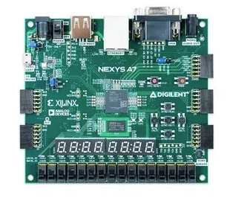
FPGA Design
Option 1, 2, 3, 4
Stopwatch:
Points:
Mode:
Level:

